Slide 1
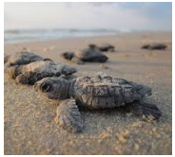
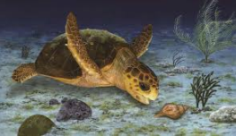
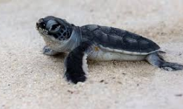
Sea Turtle Nesting Season Update
Andrew Tyler / B&CR Advisory Committee
July, 2020

Slide 2
Objectives : Goals & Methodology
Reduce the number of disoriented nests on Marco Island.
Disorientation in 2019 on Marco was 15 / 77 or 19% in 2019
Educate condominium residents and beach property managers on how they can help. Desired result is an educated and enthusiastic community.
Recommend an updated Ordinance to City Council, reflecting new understanding on Turtle behaviors since the previous Ordinance was adopted.
Assist and enable MIPD with tools to provide a more results-driven enforcement, with little to no additional resources and no added budgetary stress.
Enable functional collaboration between Collier County beach monitors, BACR and MIPD. It takes an Island (and beyond) !

Slide 3
This slide set covers the following
Objectives for 2020 Turtle Season
County-wide summary to date
One building example – Gulfview actions this year
Turtle safe lighting, what is it?
How to Assess Turtle safe lighting
“Turtle Safe “ flashlights
Collaboration with County Staff & their contribution to targeted code enforcement
Working with Code Enforcement to deliver the primary objective.

Slide 4
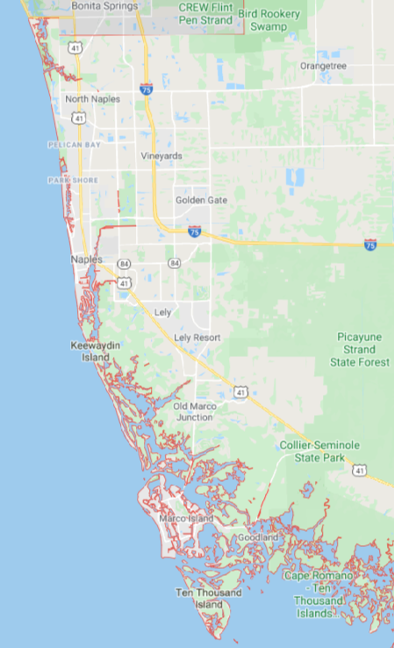
Barefoot Beach County Preserve 336 ,56 %,
Delnor Wiggins State Park 82, 70%
Vanderbilt Beach 306, 46%
Park Shore Beach 234, 55%
Numbers Collated by
Collier County, 2020 Season through end June
Total Crawls, False Crawls %
City of Naples 310, 42 %
County Averages, season to date
Total Crawls: 2755, False Crawls 58 %
Keewaydin Island 795, 65 %,
Sea Oat Island 8, 25%
City of Marco 206, 67 %
Cape Romano 237, 57 %
10,000 Islands 241, 65 %

Slide 5
Objectives
Reduce Nest disorientations among Marco Island Sea Turtle nest hatchings.
We do this by incorporating data gathered by Collier County survey staff , to
Devise a more targeted code enforcement strategy, targeting specific areas where hatchings are expected,
At minimal extra expense to the City.

Slide 6
Gulfview Condominium Efforts Colette McBreen, Condominium Manager
Assess existing external lighting, change to amber lighting where appropriate / available
Acquire materials from Sea Turtle Conservancy (no charge) to distribute among apartments
Night-time attendants monitor for potential code infractions
Call the unit / leave a note informing the occupants
Maintain a list of observations (dates, repetitive reminder calls) for end of season review by management team and board of directors.

Slide 7
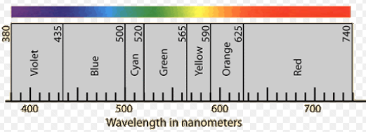
Lighting that’s safe for Sea Turtles
Turtles are sensitive to high-energy (short wavelength) light.
E = h. c / λ , where h & c are constants. E is energy and λ is wavelength
The SMALLER the value of λ the GREATER the Energy of the light
It’s not just the intensity of the light that impacts sea turtle crawls, the color /energy of the light matters more.
Keep it (wavelength) long !
λ
NOT
OK
OK
560 nm (FWC specified cut off)

Slide 8
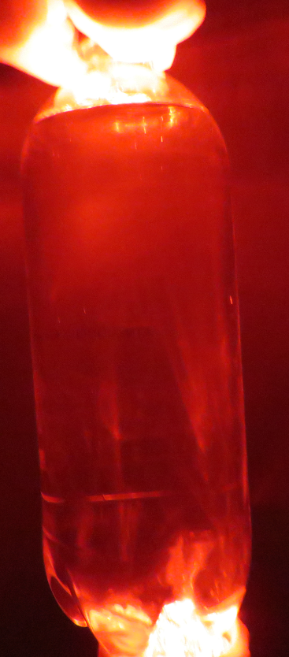
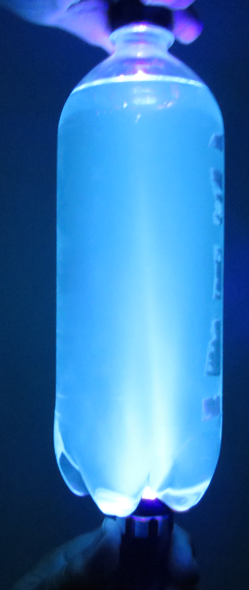
Impact of different wavelengths
Light exits liquid
Light Direction
Liquid in Soda Bottle
responds differently, according to light wavelength
Flashlight

Slide 9
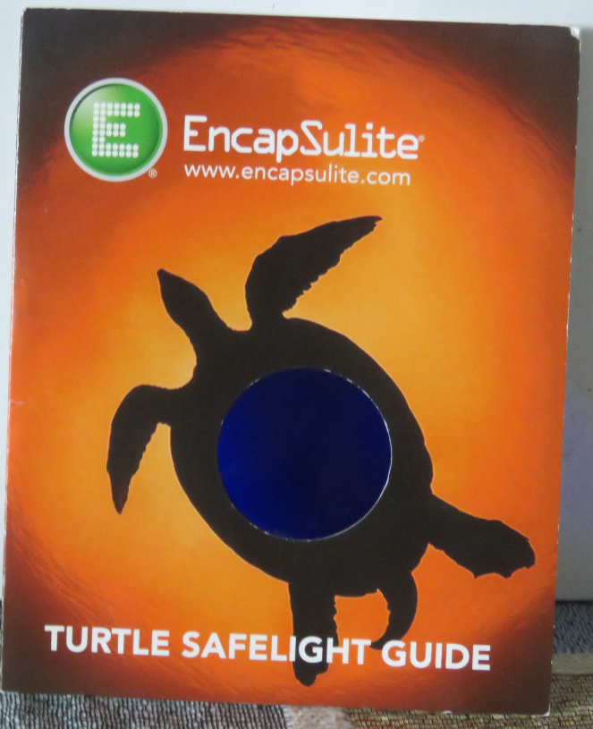
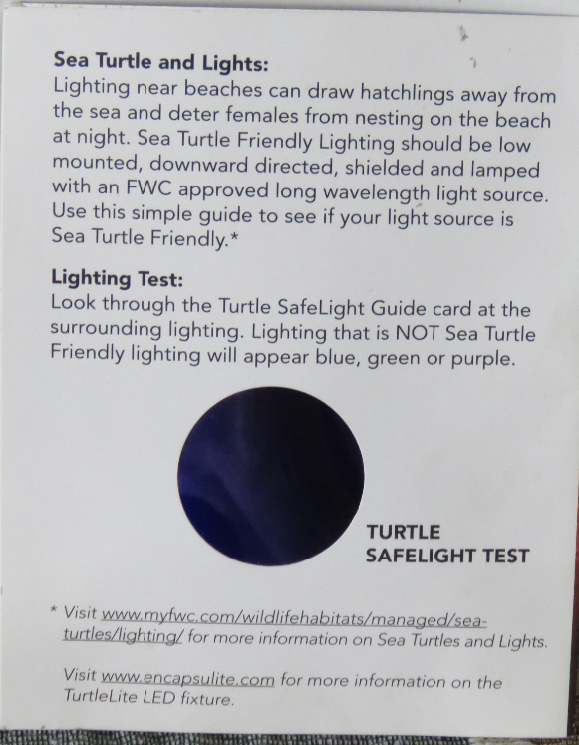
EncapSulite® filter device

Slide 10
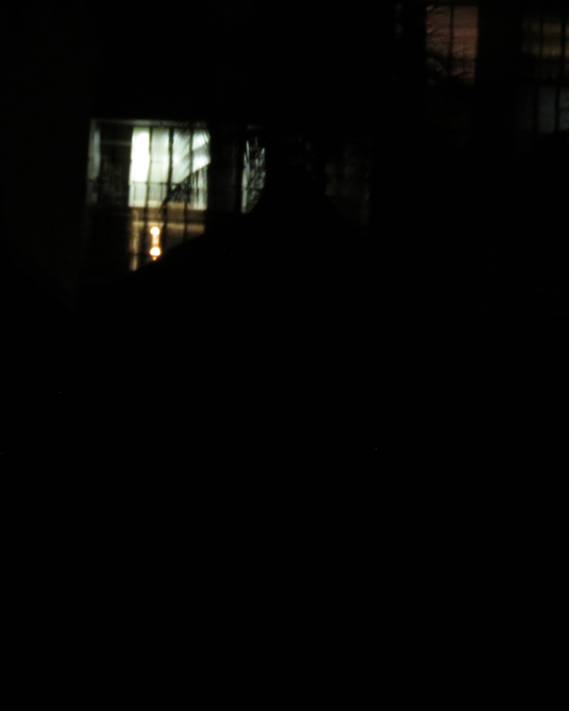
Interior light – Condominium Window

Slide 11
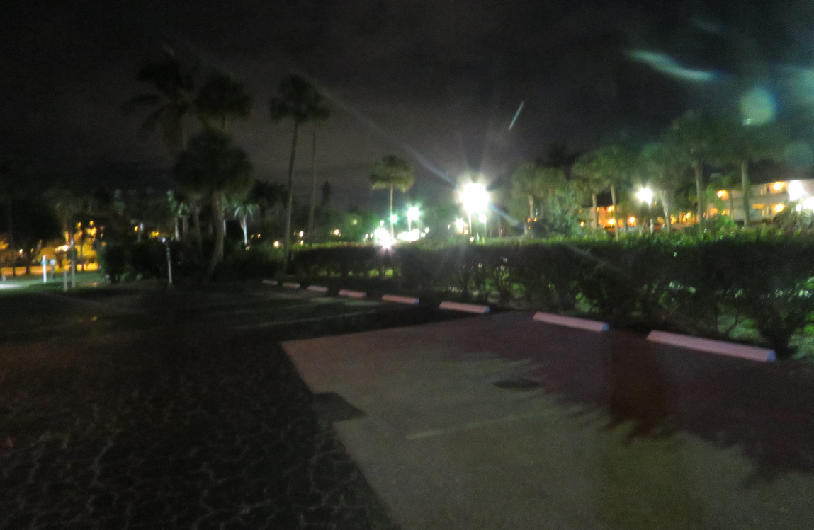
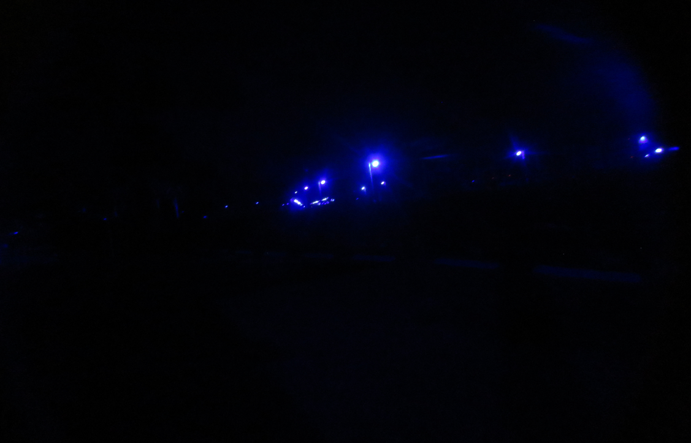
Collier Boulevard
From Gulfview parking lot, looking north.
Not beach-facing, but the same street lighting fixtures run the length of Collier

Slide 12
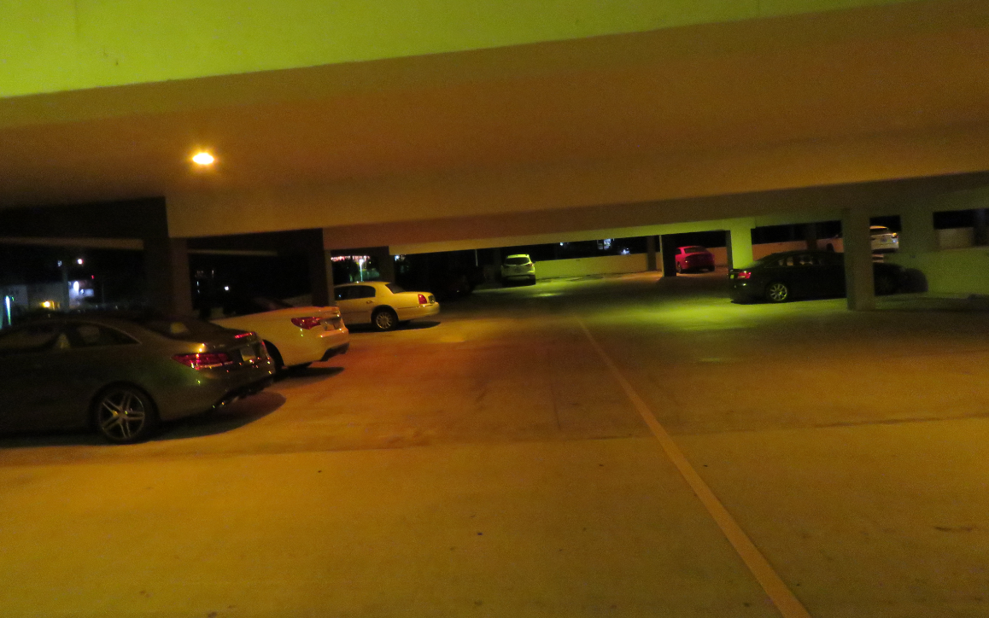
Parking Garage
Note: Blue circle shows location of exterior lights that show up in the second picture
Resident concerns regarding safety at night
February 2020 workshop with the Sea Turtle Conservancy.
They will provide funding for turtle-friendly fixtures (facility pays for installation.)
Please encourage ALL condos an hotels to sign up for a FREE consult with STC.

Slide 13
Observations on the filter
The EncapSulite® device
Is economic, estimated price $ 3 each.
Provides a diagnostic tool for specific fixtures AND can be used as a screening tool on a section of beach.
Shared with Code Enforcement (CSO Andrew Lindenmuth) for feedback assessment (not for enforcement purposes).
Things to do
Can we find specific technical information ?
What wavelengths do filtered colors blue, green and purple correspond to ?
What color corresponds to 560 nm through the filter?
https://myfwc.com/media/18511/seaturtle-lightingguidelines.pdf

Slide 14
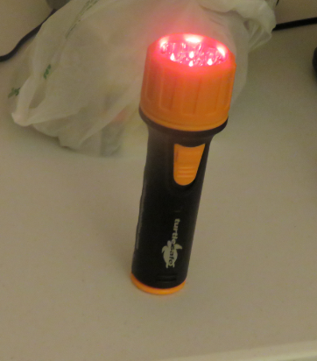
Red Light Flashlight
Turtles are unaffected by amber, orange and redlight
Flashlight obtained from turtlesafeonline.com sold as “Certified Turtle Safe Flashlight”
Seven LEDs in the lamp emit only red light
Flashlight provided to Code Enforcement for their assessment.

Slide 15
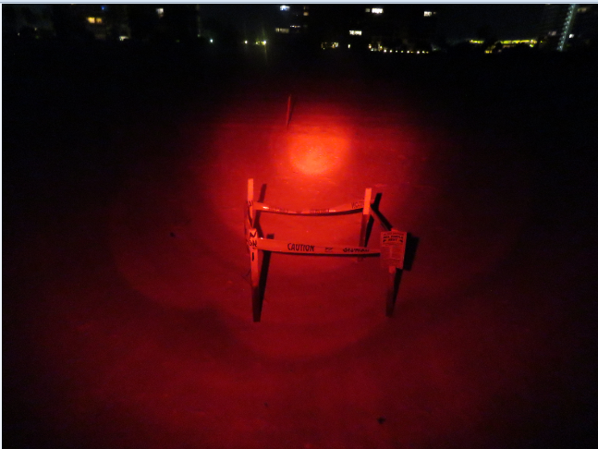
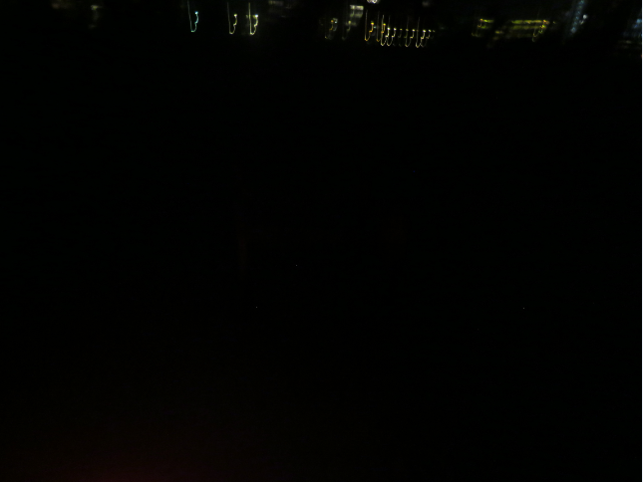
Nest close to the waterline, directly down beach from Crescent Beach condo
Photos looking back towards condo, SAME LOCATION, with and without flashlight
Shaky hands !

Slide 16
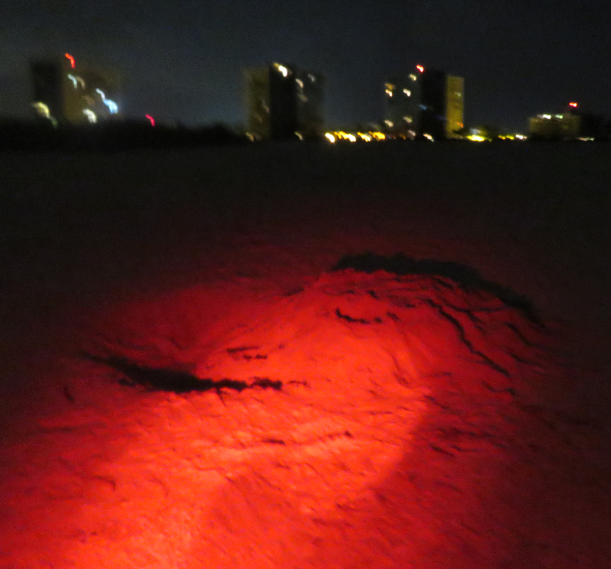
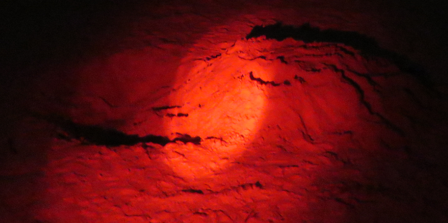
June 27 Obstacle - Big sand pit – 9:58 PM -sufficient to trap a turtle hatchling
South Seas 4 to South Seas 2

Slide 17
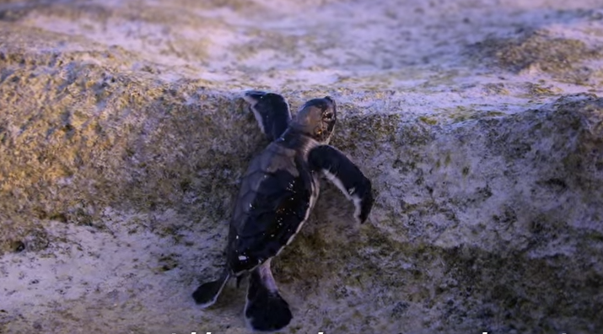
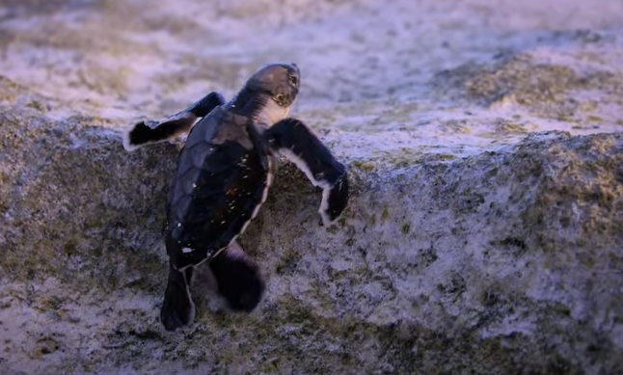
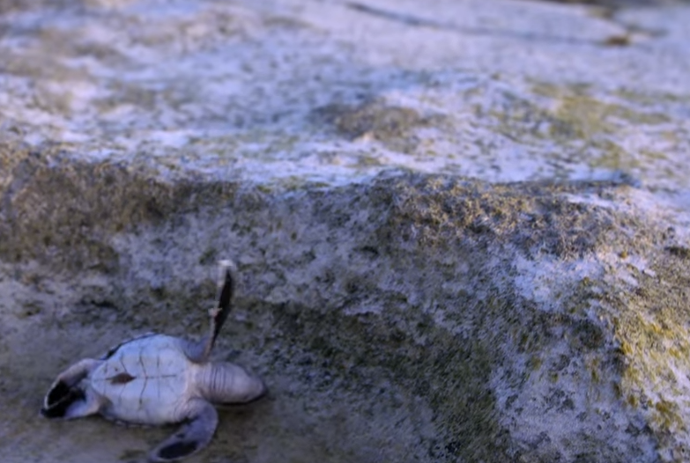
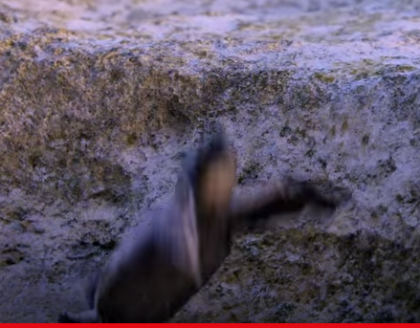
Sequence from Movie “Chasing Coral” – Netflix, (2017)

Slide 18
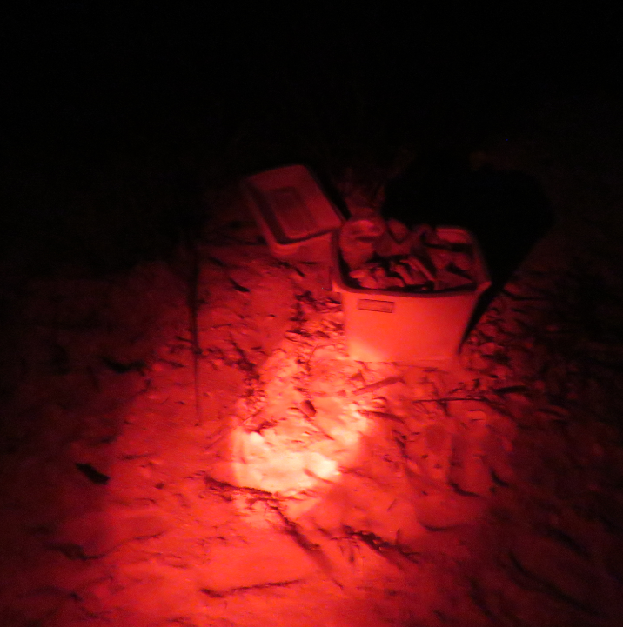
Obstacle – near to Turtle nests - Sand Dollar 9:43 PM
A Styrofoam cooler, filled with trash from a day at the beach

Slide 19
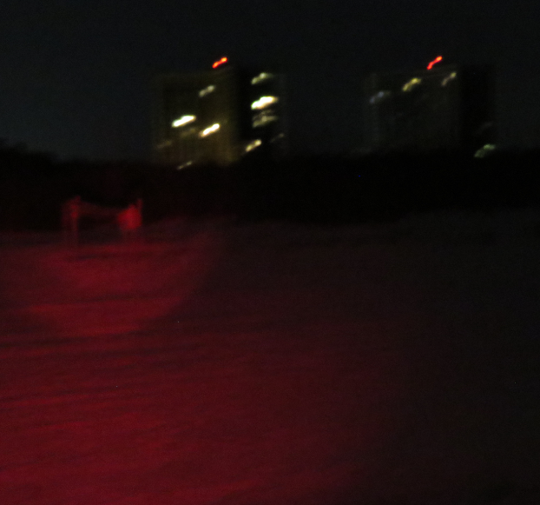
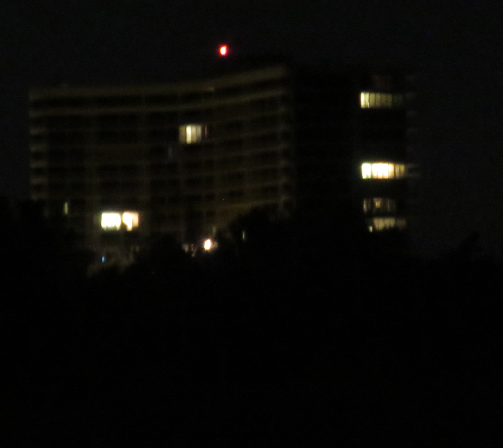
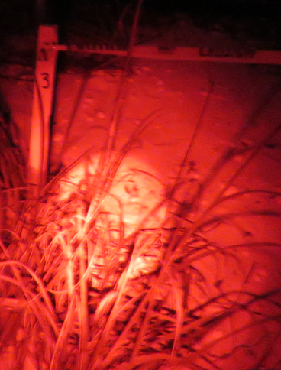
First cluster of nests past the SS IV line - 3 views, same location
SS IV
Nest
GPS
25.94530 -81.74594
Shows that lights from the northern end of the beach can illuminate the south end of Sand Dollar.

Slide 20
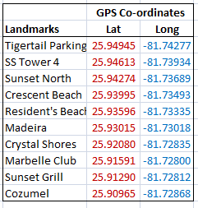
Data Collaboration with Collier County Yesenia Olvera & Maura Krause
Data reflects status July 1, 2020
TT
Res
Grill

Slide 21
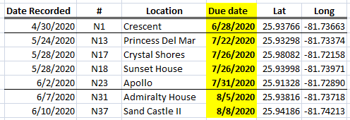
Tying it all together with Code Enforcement - 1
Nests on the beach have ANTICIPATED HATCHING DATES
Data shared with Code Enforcement
e-mail from Code Enforcement to buildings in the area of the nest ahead of time, anticipating this will encourage compliance in those buildings at the appropriate times.
Opinion - No need for ‘warning tickets’

Slide 23
Recommendation
In addition to e-mails to condominium managers, reminders to individual residents who want to sign up, “Turtle Enforcement” texts / e-mails should be delivered.
Only residents in buildings close to hatching areas would be alerted in appropriate time windows (require advice from County on ‘appropriate’)
Once established, no additional cost to the City

Slide 24
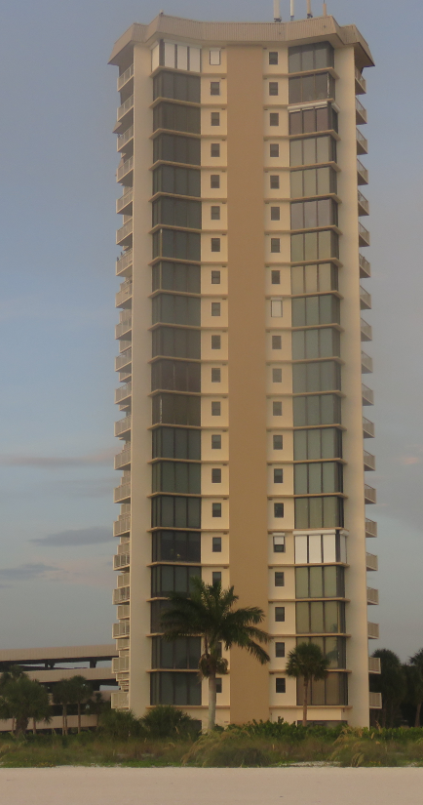
Gulfview Plan from the Beach
08 units
09 units
22nd floor
58 N. Collier Blvd
Phone #
14th floor
12th floor
In development
A ‘flip book’ of building exteriors along the beach.
Helps enforcement to identify buildings and
To estimate violation units.
Saves time, adds evidential value.
5th floor
2nd floor
Gulfview
Garage

Slide 25
Conclusions Andrew Tyler, B&CR Advisory Committee, July 2020
Making good progress on condominium education, enforcement assistance, and using the County survey data to inform targeted enforcement.
To my knowledge, the approaches we are using on Marco Island are a unique combination
Depending upon outcomes and review, the City might consider a “Handbook” of Sea Turtle enforcement guidelines, to share with other communities

