Slide 1
-Right of Way-
Plant-Life Codes

Slide 2
* What is a Right-Of-Way?
Answer: Area of property that includes Sidewalk to where street begins.
* What is the purpose of the Right-Of-Way area ?
Answer: Primarily storm water removal. But also serves as additional visitor/business parking.
(Note: No Parking allowed 2am-5am except Nov.15-Jan.15.)
* What Plant-Life is allowed in Right-Of-Way area?
Answer: according to current codes, only 3 things are allowed.
’Tree’ (Permit and Signed Agreement needed).
(4) Types of Groundcovers: SOD, Perennial-Peanut, Frog-Fruit, and Mimosa (Permit needed).
Mailbox Plant(s) 3’ max height (No Permit needed).
* What if someone wants to plant more ?
Answer: Not Allowed.
* As long as Storm-Water removal is NOT affected, can someone appeal this?
Answer: Not Allowed.
* Why Not?
Answer: ‘Per Code’.

Slide 3
CODE VIOLATION EXAMPLES
City Codes are established to protect the health, safety and welfare of residents and visitors of Marco Island. The Code Compliance Division of the Marco Island Police Department is responsible for enforcing the City’s Code of Ordinances. Code Compliance officers recognize the importance of maintaining the quality of life that Marco Island residents and property owners deserve and enjoy.
If a property owner is found to be in violation of a City Code and does not take corrective action, a citation is issued or the case is referred to the Code Enforcement Board. A property owner can be fined up to $250 for each day a violation exists on their property. The following are some examples of code violations.
Right-Of-Way Obstructions
The public right-of-way includes the sidewalk, swale and street in front of private property.
Property owners are required to maintain the sidewalk and swale on both developed and undeveloped properties. Common violations of sidewalk or street obstructions are listed below. Do not:
Park vehicles across the sidewalk.
Place devices, such as basketball nets, on the right-of-way.
Allow landscaping to grow so that it encroaches over the sidewalk. Branches from trees must be no lower than 7 1/2 feet from the sidewalk.
Install landscape (planting flowers, trees or shrubs) or irrigation systems in the right-of-way without a permit from the Public Works Department.
Park overnight in the right-of-way.
Obstruct the right-of-way so motorists and pedestrians do not have a clear view at an intersection.

Slide 4
1. No permit is required to perform grass maintenance in public right-of-ways.
2. All permitted trees and plant material placed in public rights-of-way do not create or vest any property right in association with a permit, except in the city. Permittees shall be responsible for the maintenance of such trees and plant material, as provided herein, unless otherwise removed or specified as a condition of the permit issued pursuant to section 42-76.
3. A property owner desiring to privately landscape the public right-of-way shall submit a landscape and irrigation plan to the city manager or designee. The application shall include three sets of detailed plans indicating existing rights-of-way facilities, type and location of proposed plantings, and location of electrical and irrigation systems.
4. After review and acceptance of the landscape and irrigation plans, a landscape agreement shall be signed by the permittee to insure that the permittee or his or her successor or assignee shall be responsible to maintain such material and irrigation systems until removed or otherwise specified. The agreement shall be recorded in the official records of Collier County.
5. Tree planting distance from the edge of the sidewalk on private property shall be no closer than 36″ from the trunk of tree. Under no circumstances shall trees be planted within the flow line of a swale regardless of the setback from the edge of the sidewalk.
6. Tree plantings must not interfere with line of sight triangles at anytime or with ingress or egress to the property.
7. Trees planted in the public right-of-way in close proximity (less than ten feet) to underground utilities shall be reviewed and approved by the city manager or designee.
8. Trees planted in the public right-of-way under power supply lines shall be of the type that do not grow taller than 15 feet. The owner shall be responsible to maintain trees under or adjacent to the power supply to prevent power failure.
9. Existing private trees located in the public right-of-way may be adversely impacted by various underground construction activities undertaken by the city. The city shall not be responsible for any adverse impact on existing private trees in the public right-of-way from underground activities undertaken by the city.

Slide 5
SECTION 13: SOD & APPROVED GROUNDCOVER SPECIES PLACEMENT
1. Sod and other approved groundcover plant species placement requirements in public right-of-way and easements:
The permittee or appropriately licensed contractor, if designated as an authorized agent, must apply for a right-of-way construction permit to perform sod or other approved ground cover plant species (Perennial Peanut and Sunshine Mimosa) installation work and I or maintenance thereof in public right- of-way. Appropriate design drawings or sketches are required and shall be submitted…
Grass sod shall be Centipede, Bahia grass, or St. Augustine type and shall be well matted with grass roots, except that where sodding will adjoin or be in sufficiently close proximity to private lawns, the existing type of sod must be used. Materials and construction methods of sodding shall meet the requirements of Section 570 of the FOOT Standard Specifications.
Where City Public Works Director deems acceptable, grass seed shall be a mixture of 20 parts of Bermuda seed and 80 parts of Argentine Bahia. Materials and construction methods of grassing shall meet the requirements of Section 575 of the FOOT Standard Specifications
Grass SOD, Perennial Peanut, sometimes described as Echo Turf (Arachis glabrata Berth) and Sunshine Mimosa, sometimes described as Powder Puff (Mimosa strigillosa) are the approved groundcovers plant species that shall be used as alternative plant species for groundcover other than sod or turf in the right of way areas.
Note: FrogFruit GroundCover recently added.

Slide 7
Andrew-
…review Ordinance 15-18, it will give you directions on what can be planted within the R/W. As of this date, there is no means for an exception or variance.
tim
Timothy E. Pinter, P.E.
Public Works Director
City of Marco Island Public Works Engineering
50 Bald Eagle Dr.
Marco Island, Florida 34145
Tim Pinter <TPinter@cityofmarcoisland.com> | Mon, Mar 19, 2018 at 1:15 PM
To: Andrew Kirlin <andrew.kirlin@gmail.com> Cc: David Baer <DBaer@cityofmarcoisland.com>, Daniel Smith <dsmith@cityofmarcoisland.com>, Guillermo Polanco <gpolanco@cityofmarcoisland.com>

Slide 8
Andrew,
In regard to plant selection whether it be trees, shrubs or in this case ground covers, diversity is more sustainable than a monoculture.
As long as the plant is not categorized as invasive, I would broaden the ground cover selection to include some other species….to get more genetic heterogeneity which will help prevent total annihilation or aesthetic damage caused by a new insect or disease or weather. Plus, different species would add more interest w flowers or textural differences.
St. Augustine grass should be limited due to its high maintenance requirements (fertilizing, watering and mowing- especially hazardous on small medians) and potential chemical pollution of nearby surface waters from fertilizer and pesticide applications. We have several ground cover lists available through myself or UF|IFAS.
Hope this helps! Please contact me on further details!
"Helping you to Protect the Environment and Beautify Your Landscape"
Doug Caldwell, Ph.D.
Caldwell,Doug L <dougbug@ufl.edu>
To: andrew kirlin andrew.kirlin@gmail.com Tue, Jul 31, 2018 at 4:01 PM

Slide 9
The 2018 Florida Statutes
Title XXVIII NATURAL RESOURCES; CONSERVATION, RECLAMATION, AND USE
Chapter 373 WATER RESOURCES
373.185 Local Florida-friendly landscaping ordinances.—
(a) “Local government” means any county or municipality of the state.
(b) “Florida-friendly landscaping” means quality landscapes that conserve water, protect the environment, are adaptable to local conditions, and are drought tolerant.
(c) A local government ordinance may not prohibit or be enforced so as to prohibit any property owner from implementing Florida-friendly landscaping on his or her land.

Slide 10
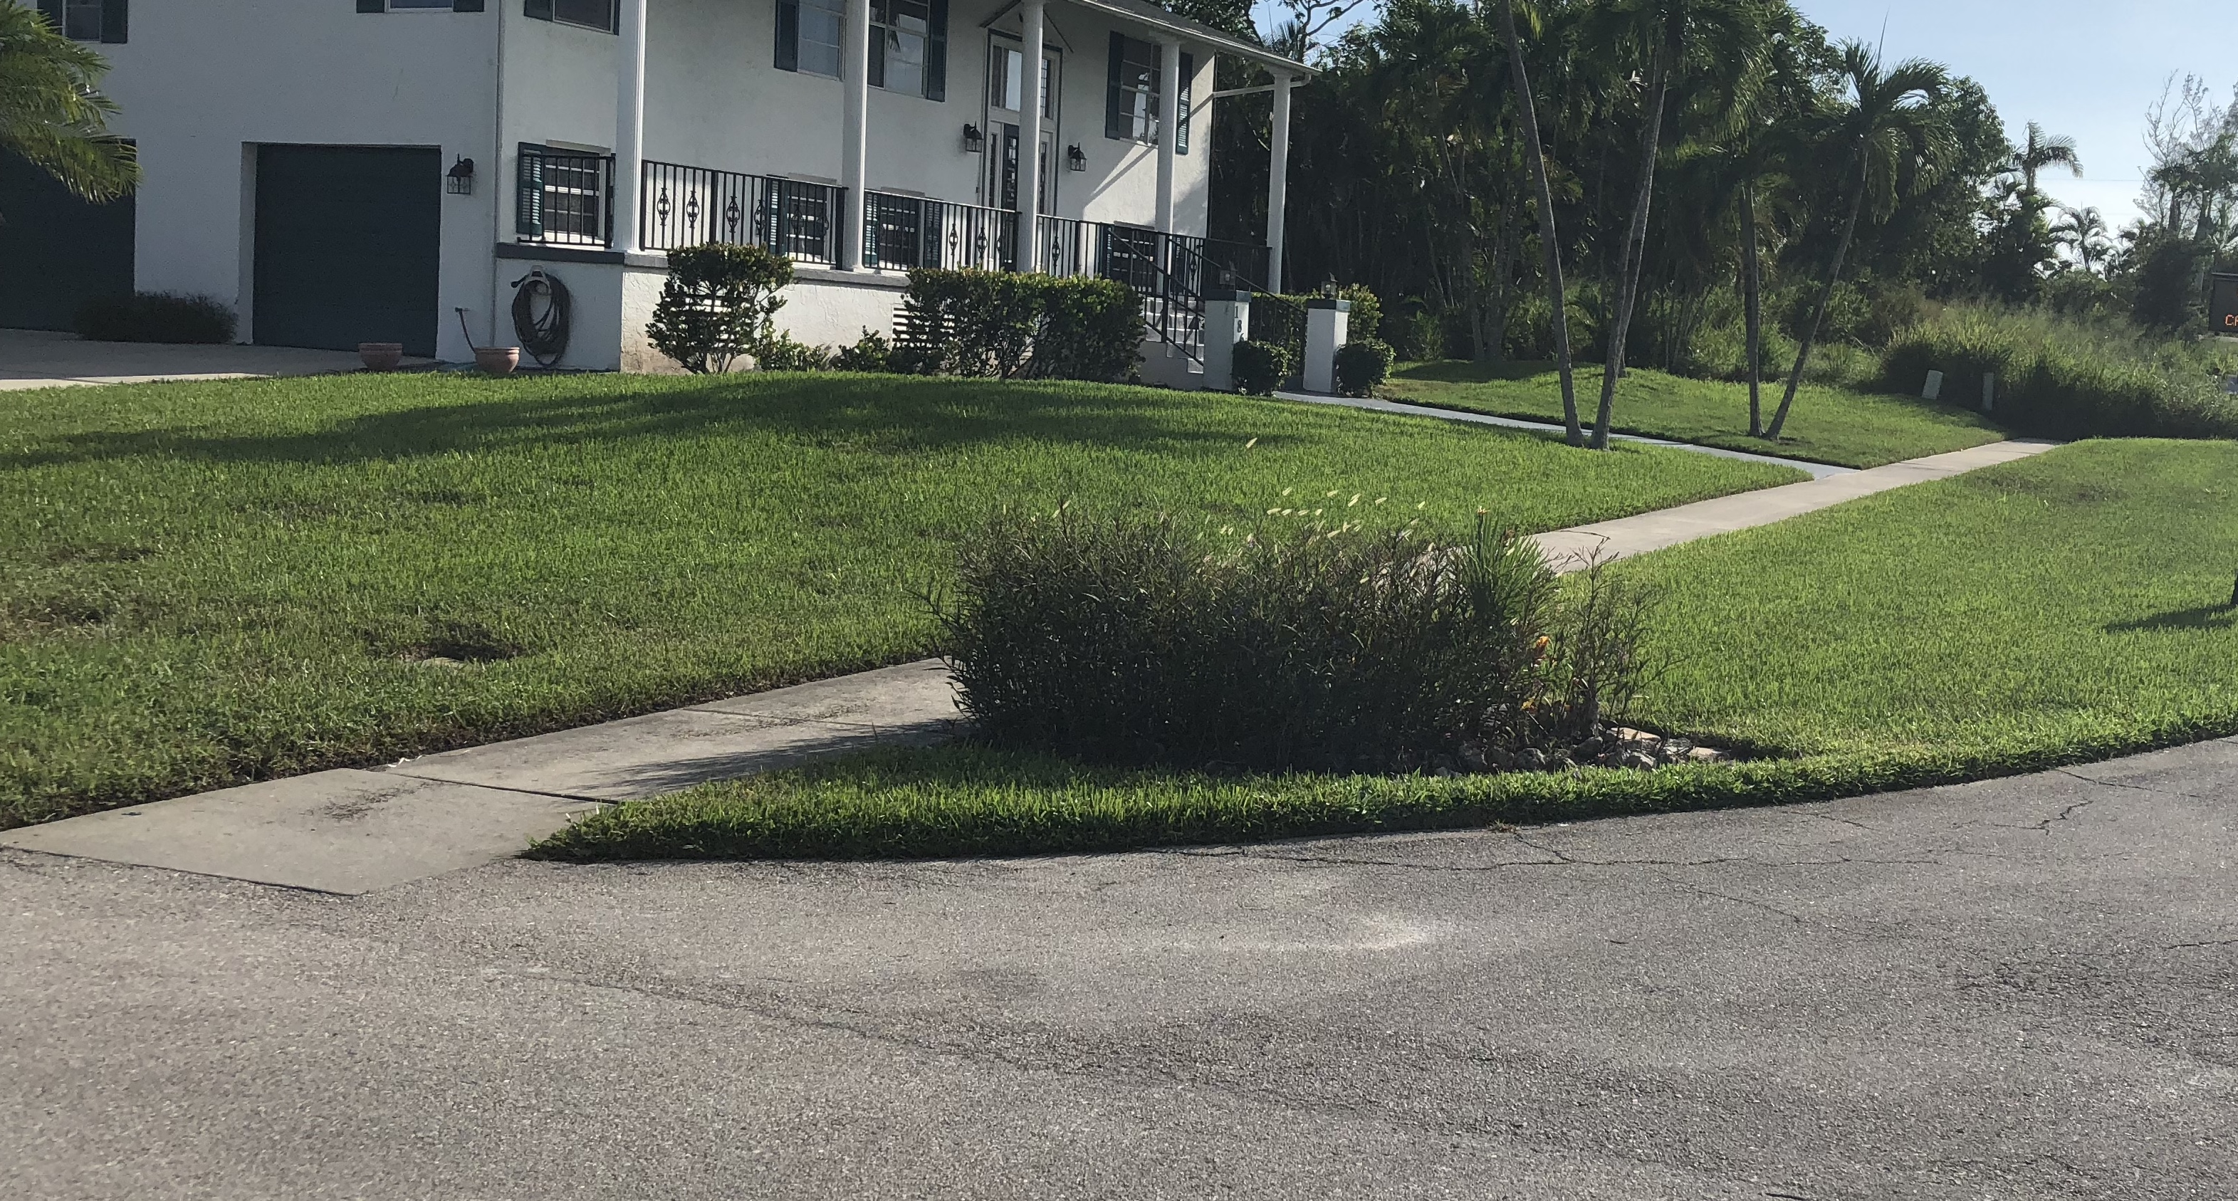
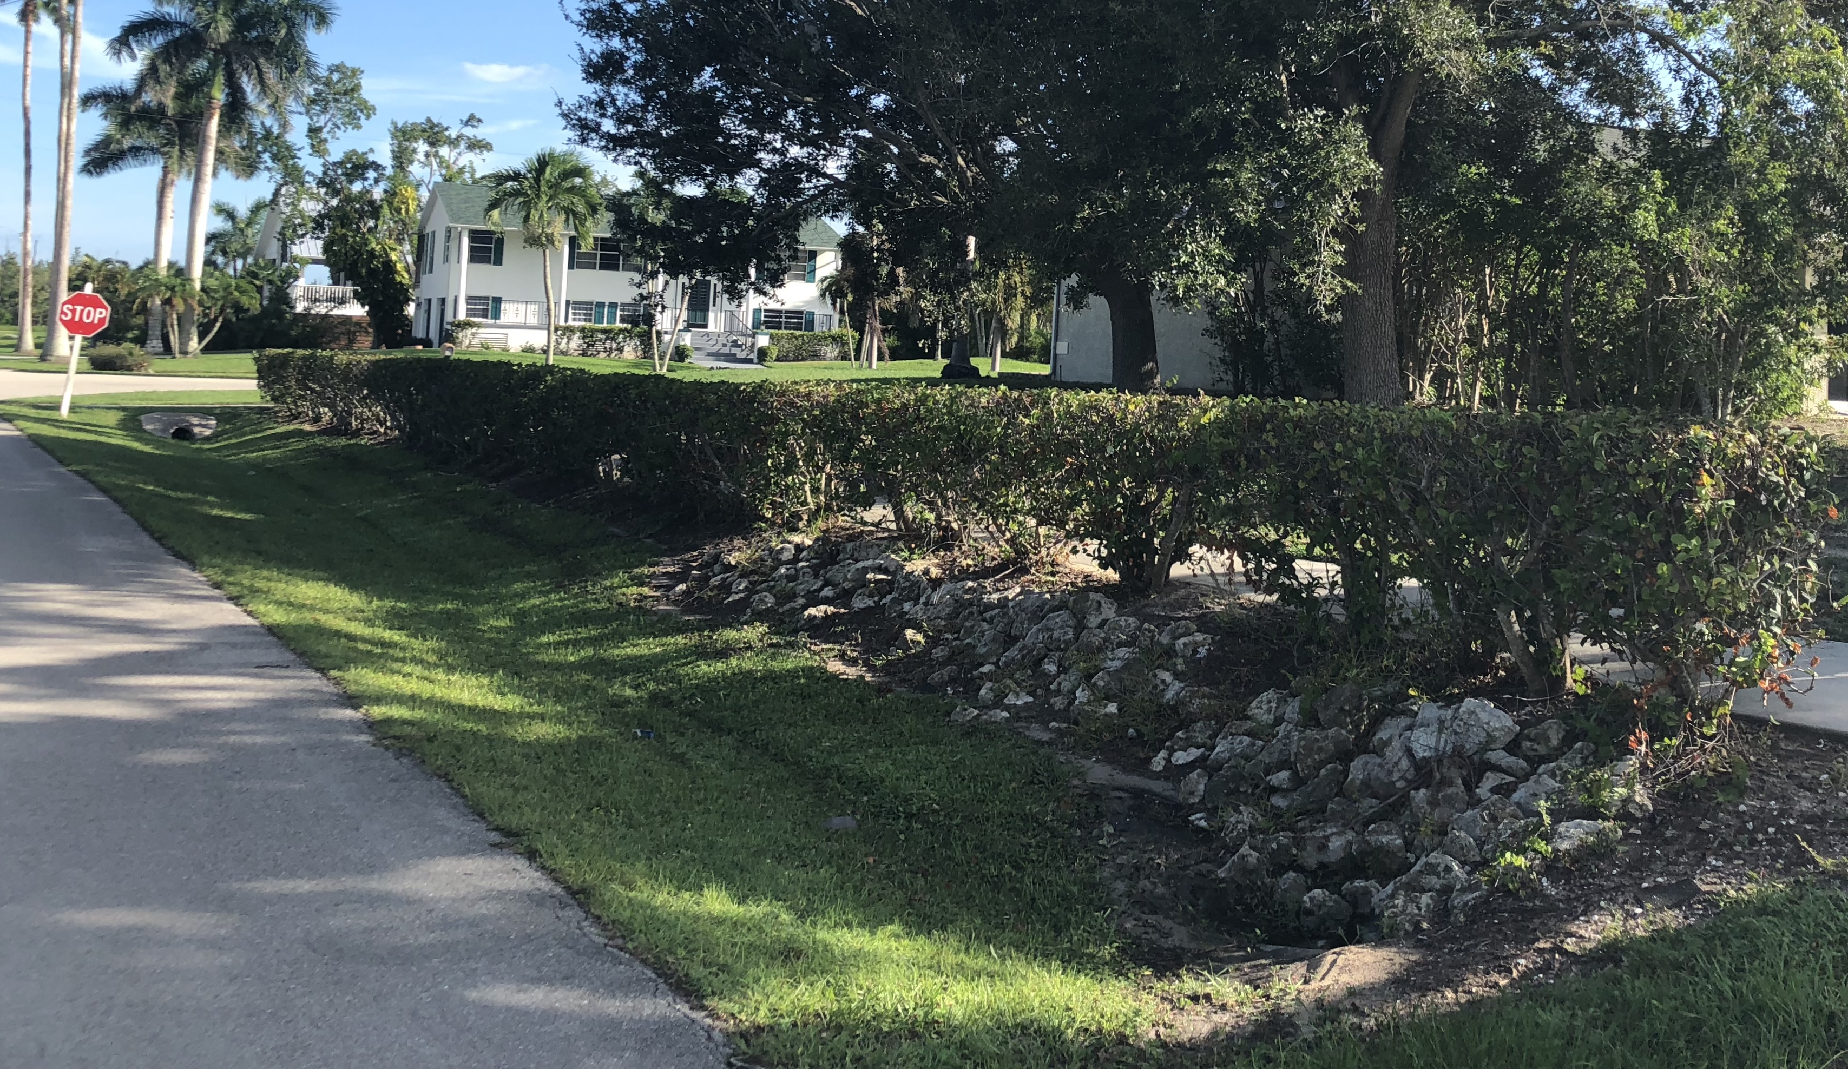
Notes:
Examples Of Violations:

Slide 11
Notes:
Examples Of Violations:

Slide 12
Notes:
Examples of Violations:

Slide 13
CONCLUSION…. Possible Solution?
What is the problem with current Right-Of-Way planting codes?
* Too restrictive.
Possible Solutions?
*Allow more types of “Florida-Friendly” type plants, shrubs, and groundcovers to be used in Right-Of-Way.
How?
* Amend the codes to allow a process by which land/home owners can get a permit to use more diverse plant-life than what is currently allowed.
What if permit does NOT allow adding additional plant-life?
* Allow appeal process, called Variances, to be issued under same process afforded to other Variances.
What is that process (for Variances)?
* Variance is requested from Planning Board Committee based on your own unique situation.
* Planning Board Committee makes a decision and sends their recommendation to either allow or deny to City Council.
* City Council votes to either allow or deny variance; using Planning Board Committee’s recommendation as guidance.
What restrictions MUST ALWAYS be required (no exceptions)?
* Cannot restrict storm-water movement.
* Cannot impede sight triangle.
* Cannot blocks city signs.
* Cannot Obstruct the right-of-way so motorists and pedestrians do not have a clear view at an intersection.
* Must sign Planting Agreement.
* Any Others?

