Slide 1
Marco island water quality monitoring
Presented to the City of Marco Waterways Advisory Committee
February 16, 2017
Rhonda J. Watkins, Principal Environmental Specialist
Collier County Pollution Control

Slide 2
Background
Water quality monitoring established by City of Marco in ~2001
12 sampling sites selected by City of Marco
Sampling frequency varied from monthly to every other month
Fecal Coliform, Enterococcus, Total Kjeldahl Nitrogen (added ~2006)
Analyzed by Pollution Control Lab or Contracted Laboratory—NELAC Certified

Slide 3
Background
2007-2014
Same 12 sites sampled every other month
Fecal, Enterococcus, TKN
Data not entered into Florida Department of Environmental Protection’s (FDEP) STORET (STOrage and RETrieval) database
Not sampled under a required Field Sampling Quality Manual

Slide 4
current monitoring
2015-present
Same 12 sites sampled quarterly
Expanded parameter list to allow assessment of the Numeric Nutrient Criteria
Collected by Collier County Pollution Control staff
Follow FDEP standard operating procedures under the required Field Sampling Quality Manual (Florida Administrative Code 62-160).
Collect field quality control samples to ensure samples are collected cleanly and accurately
Field meters are calibrated daily
Data are uploaded annually to FDEP’s STORET database.

Slide 6
current monitoring
Sites are all sampled from land using direct grab samplers
Access to some sites is becoming difficult due to build-out and may have to be relocated
Current cost of monitoring $9,170.70
Field Sampling $4,626.72
Analytical Services $3,325.28
STORET data upload $1,218.70
Dissolved oxygen, specific conductivity, salinity, pH, temperature, nitrate, nitrite, total Kjeldahl nitrogen, total nitrogen, total phosphorus, chlorophyll-a, enterococcus, fecal coliform
Fecal coliform was removed in May 2016 due to new, more sensitive standards

Slide 7
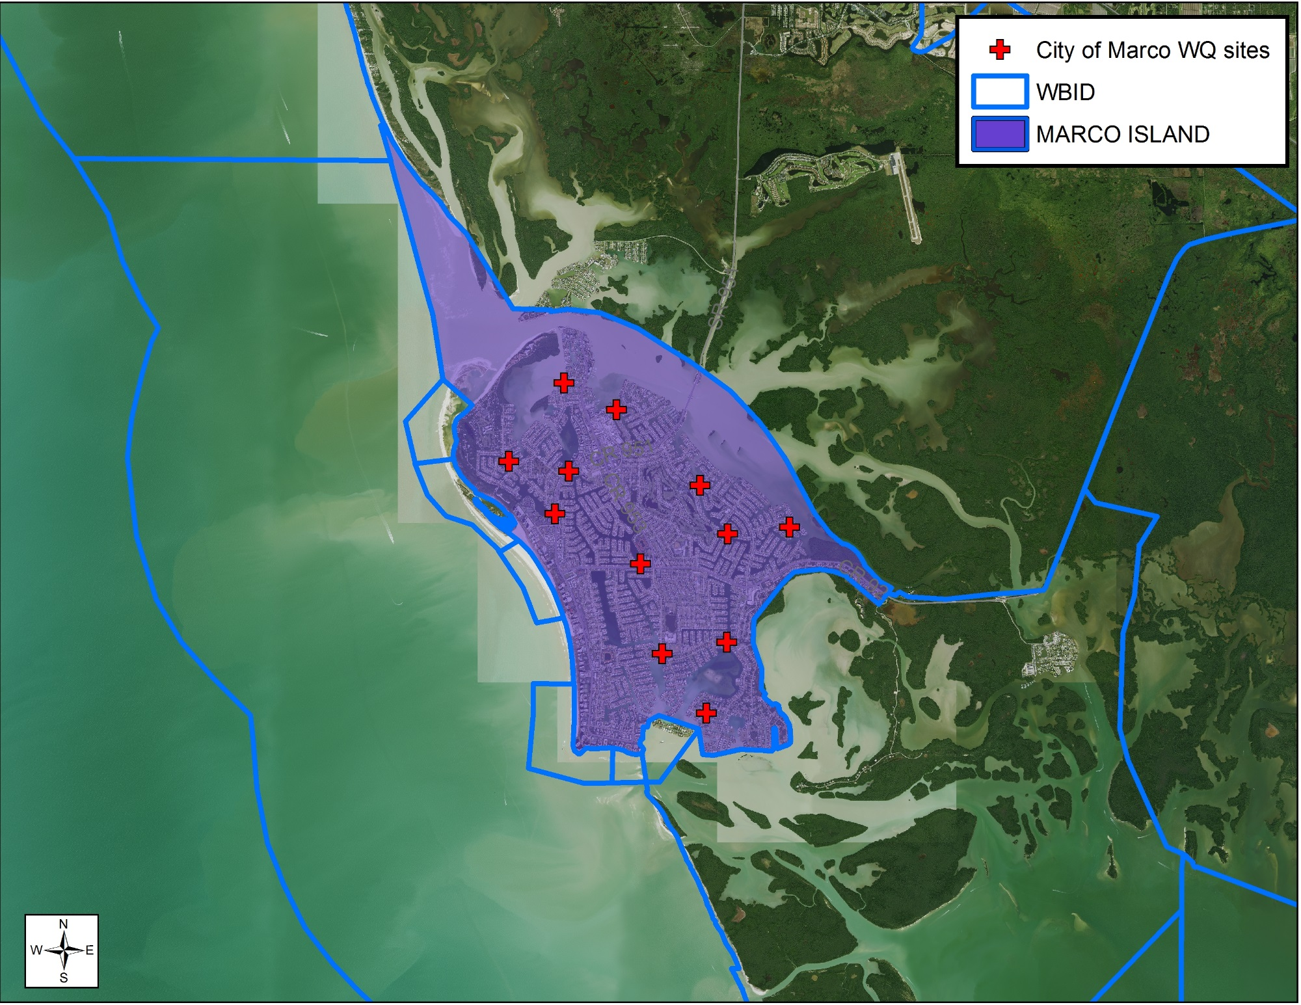
WBID—WaterBody IDentification

Slide 8
Impaired waters assessment
Florida Administrative Code (FAC) 62-303—Impaired Waters Rule (IWR)
Assessed every 5 years
Last assessment of WBIDs in Collier County was 2011-2012
Next assessment in Collier County is not until 2019 due to addition of new criteria (bacteria, dissolved oxygen, nutrients) and need to gather more data.
Marco Island currently has no impairments based on data collected prior to 2006 by FDEP and Florida International University (via South Florida Water Management Contract)
Statewide TMDL for mercury

Slide 9
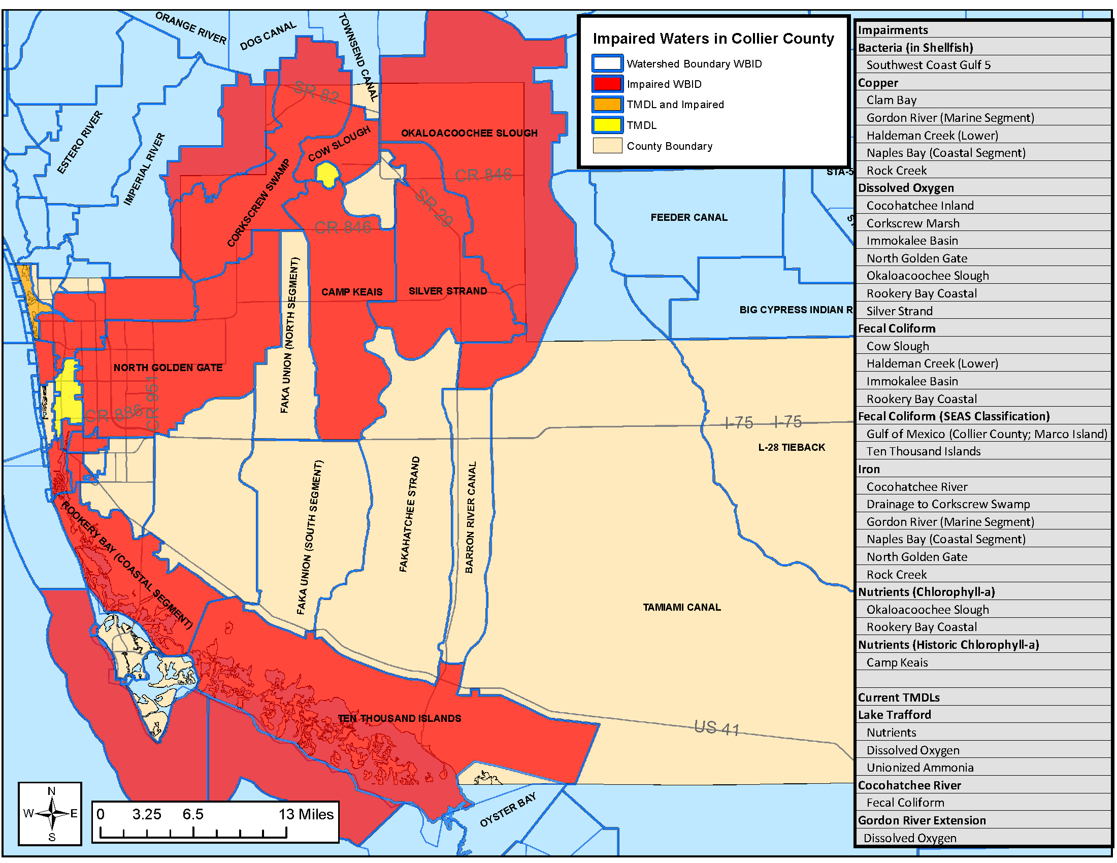
Impaired waters and tmdls
Total Maximum Daily Load

Slide 10
Impaired waters assessment
Rookery Bay Coastal WBID directly upstream is impaired for dissolved oxygen, fecal coliform and nutrients
Slated for TMDL development in 2020 for nutrients, dissolved oxygen and unionized ammonia
Fecal coliform is not a priority as FDEP has an ongoing effort to update the fecal indicator bacteria criteria to implement a statewide TMDL (FDEP Priority Framework Document)
New bacteria criteria were adopted in 2016
Offshore WBID 8064 is listed as impaired for fecal coliform
Not based on actual fecal coliform samples or results
Based on shellfish harvesting south of Cape Romano area being “conditionally approved”
“Conditionally approved” status based on rain events and probability of increased bacteria.
FDEP intends on redrawing the WBID boundaries to exclude shellfish harvesting area thus removing artificial impairment

Slide 11
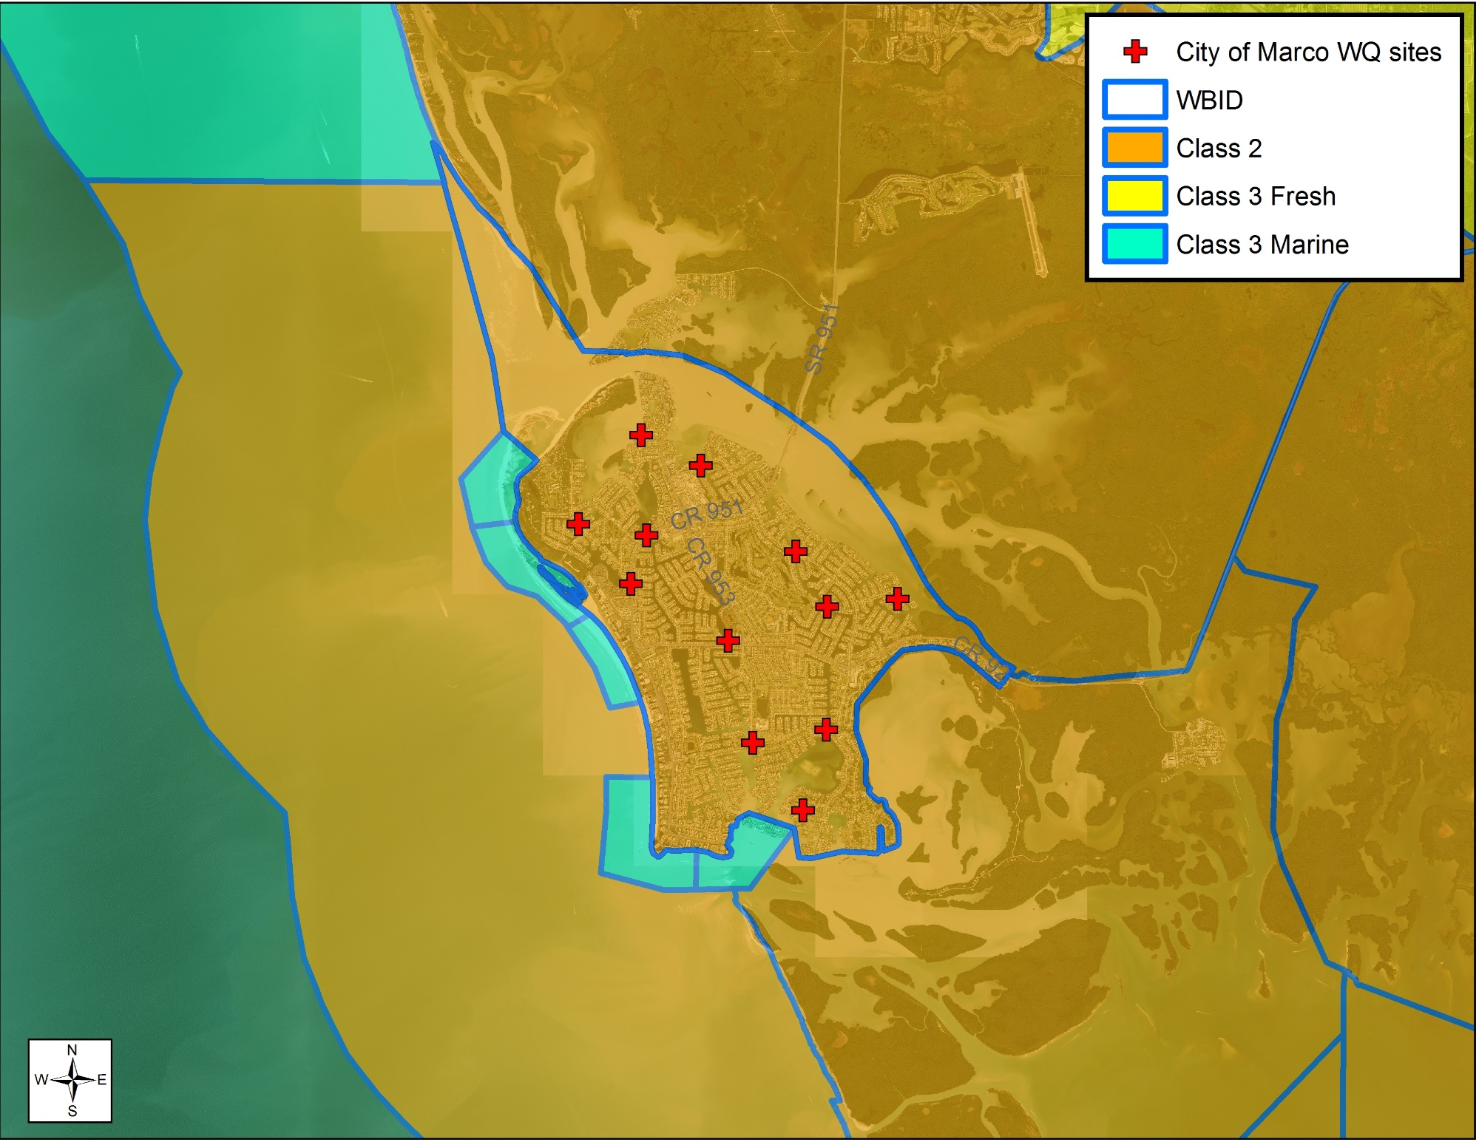
Class II-Shellfish Propagation or Harvesting
Class III--Fish consumption; recreation, propagation and maintenance of a healthy, well-balanced Population of fish and wildlife
Water Use Classifications (FAC 62-302)

Slide 12
Impaired waters assessment
Water Quality Standards
Marco Island WBID is classified as Class II (marine waters)
Designated use is for the propagation and harvesting of shellfish
Class II Standards can be found in FAC 62-302
Fecal coliform Criteria
FDEP established new bacteria standards in 2016
FDEP adopted EPA’s national recreational water quality criteria using Enterococcus in marine waters and E. Coli in fresh waters
Class III Marine uses Enterococcus
Class II uses Fecal Coliform
Fecal coliform is not a good indicator of human pathogens
There are no approved shellfish harvesting areas in the Marco Island WBID

Slide 13
Impaired waters assessment
Numeric Nutrient Criteria (NNC) for estuaries established in 2015
State is divided into Estuarine Nutrient Regions (ENR)
Marco Island WBID has not been assessed for NNC
City’s Data collected prior to 2015 are not in STORET
FDEP will only assess data in STORET (FAC 62-160)
Must have 3 years of data to assess for numeric nutrient criteria
Based on annual geometric mean
Not to exceed once in 3 years

Slide 14
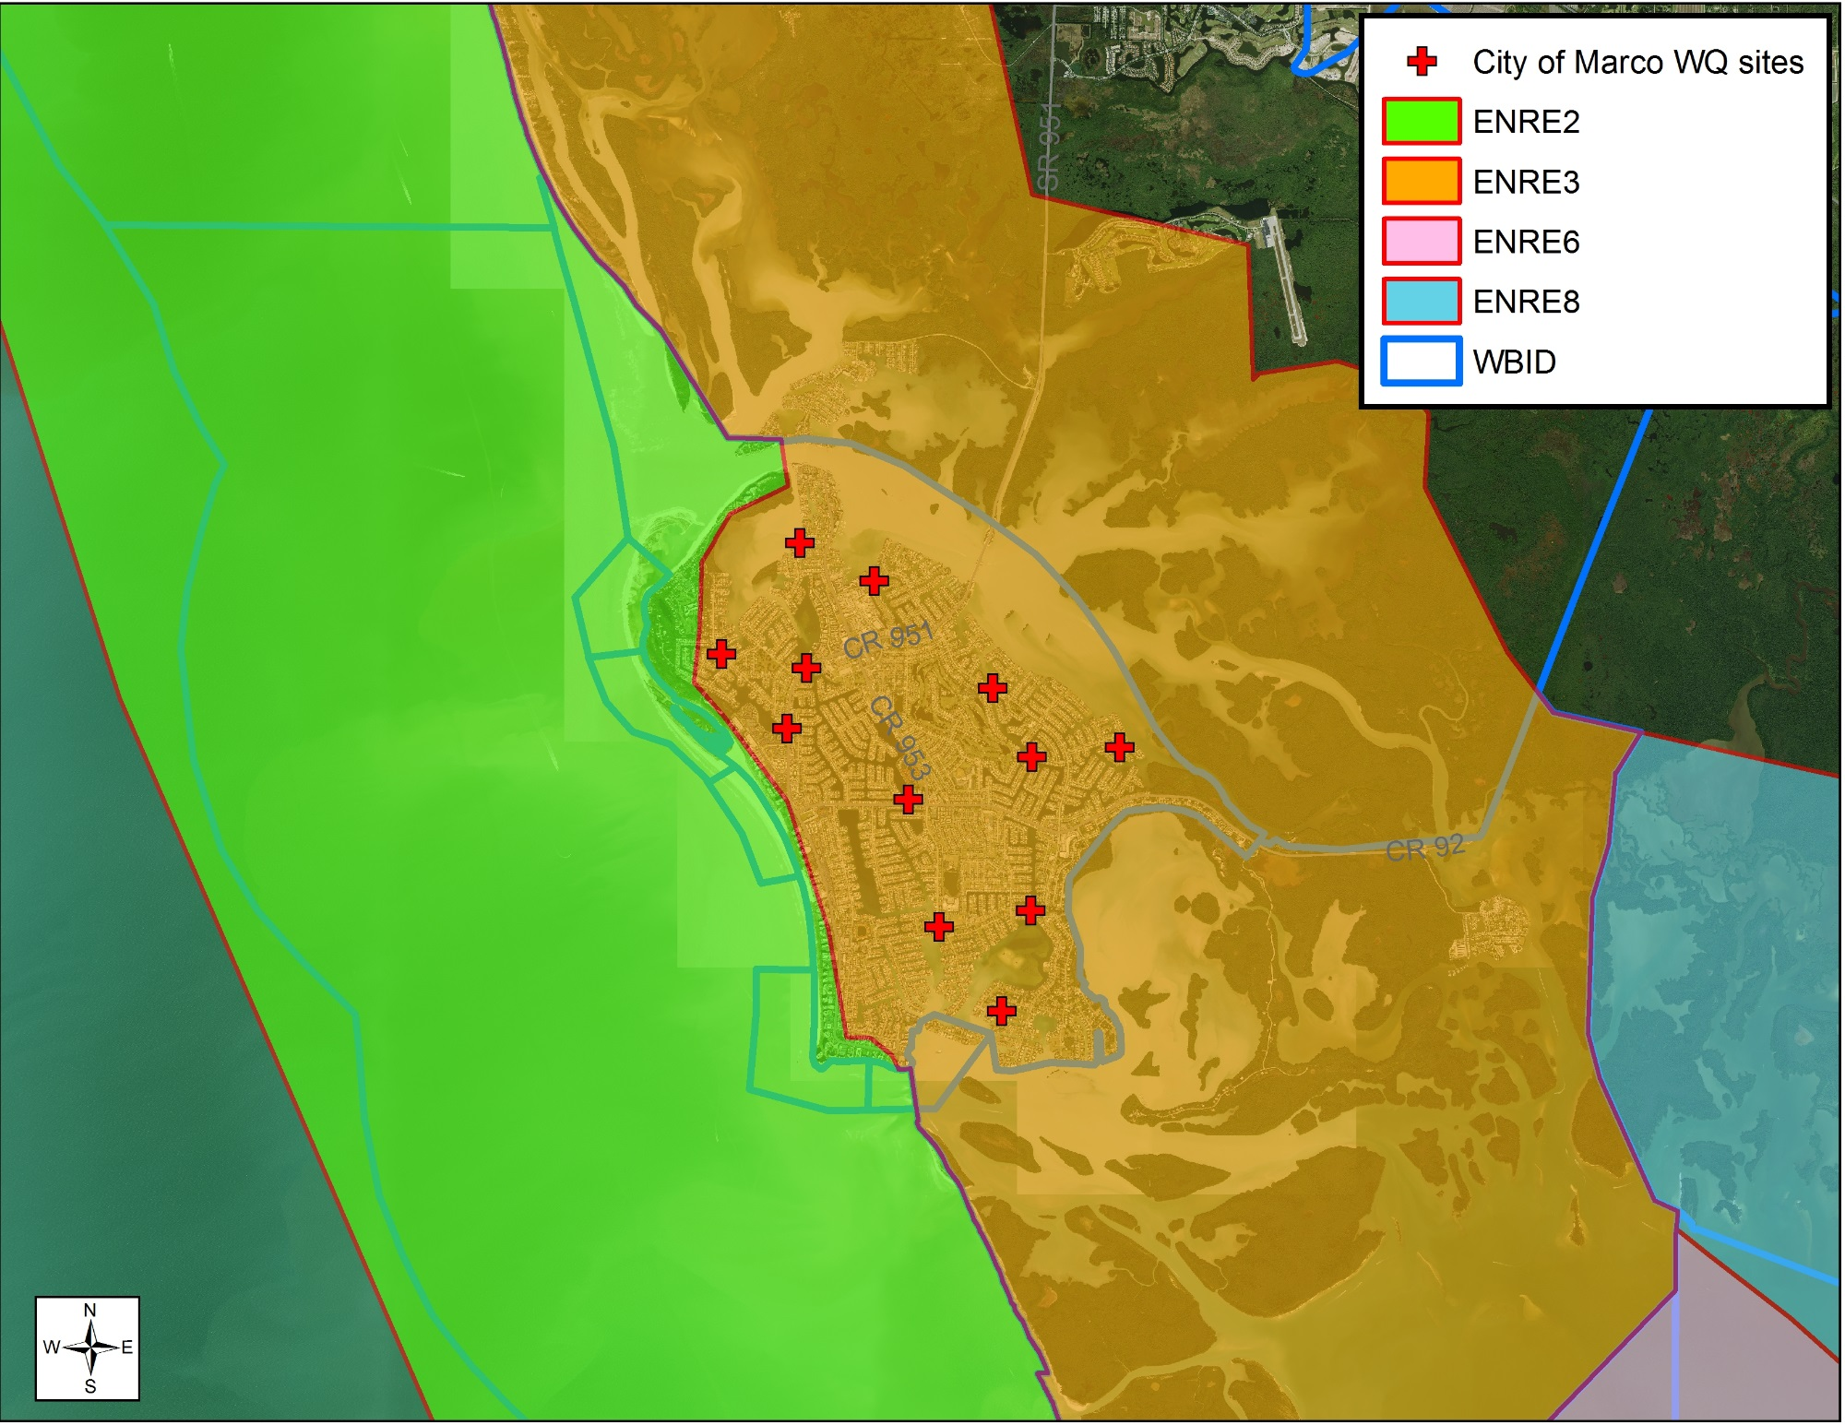
ENRE4 Criteria
Naples Bay
TN: 0.57 mg/L
TP: 0.045 mg/L
CHLa: 4.3 ug/L
ENRE3 Criteria
TN: 0.30 mg/L
TP: 0.046 mg/L
CHLa: 4.9 ug/L
ENRE2 Criteria
TN: 0.25 mg/L
TP: 0.032 mg/L
CHLa: 3.1 ug/L
ENRE8
TN: 0.41
TP: 0.053
CHLa: 4.1 ug/L
ENRE6 Criteria
TN: 0.26 mg/L
TP: 0.016 mg/L
CHLa: 1.4 ug/L
Estuarine Nutrient Regions (FAC 62-302)

Slide 15
Questions?

